Slide 1
Safe Driving Application Using Smartphone
presentation
3조: 이유호, 윤지영, 정지란
https://github.com/augdriv/
Notes:
안녕하세요, 증강도로주행을 주제로 발표를 맡은 이유호입니다.

Slide 2
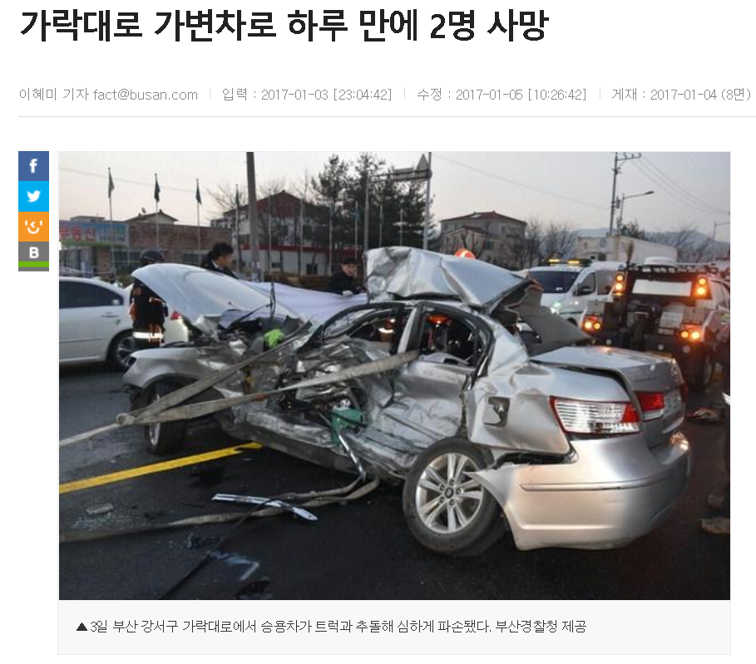
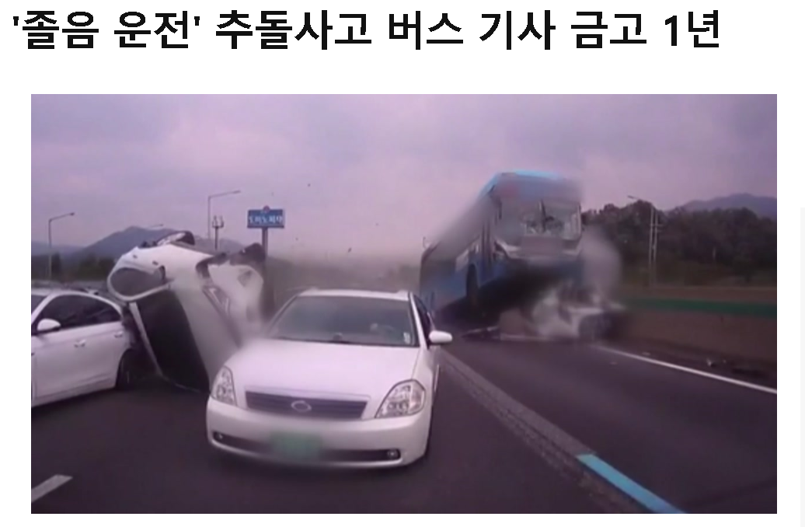
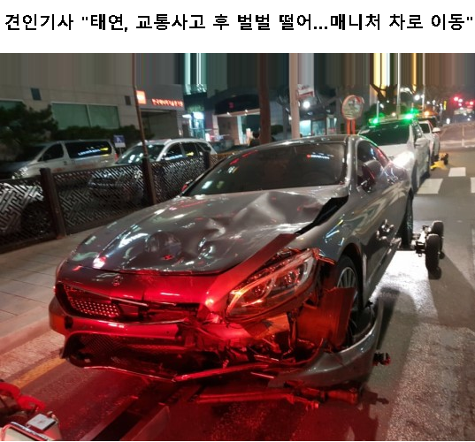
Background
3조: 윤지영, 이유호, 정지란
Safe Driving Application
YOUR DESTINATION IS REWARD FOR SAFE DRIVING
Too many car accidents!
Many solutions have been developed for safe driving
Although these solutions have been adopted, they are not enough to prevent car accidents since accidents still occur
Many solutions are under development
e.g. Auto driving system, HUD display, etc

Slide 3
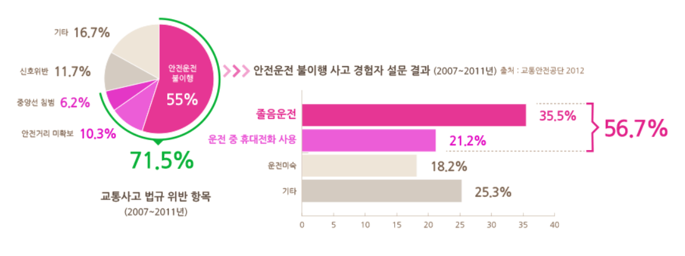
Background
3조: 윤지영, 이유호, 정지란
Safe Driving Application
YOUR DESTINATION IS REWARD FOR SAFE DRIVING
Drowsy driving is as dangerous as driving under the influence of alcohol.
Studies show that more than 80 percent of eyelids are covered during one minute, which increases the risk of accidents.

Slide 4
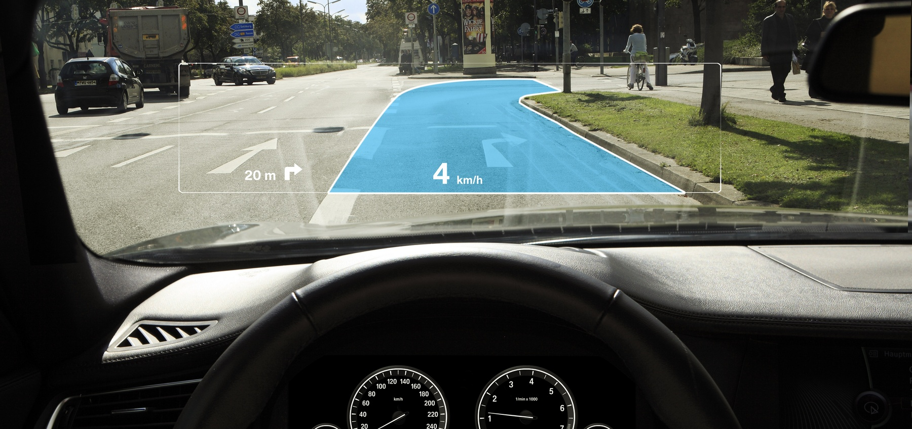
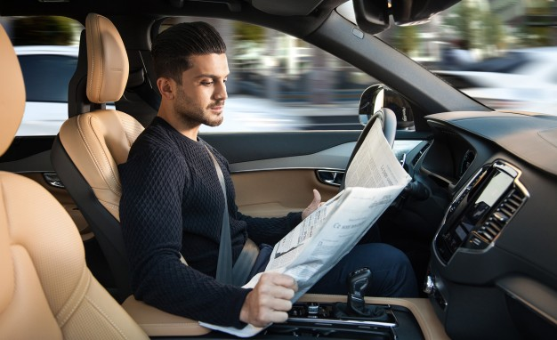
Motivation
Safe Driving Application
YOUR DESTINATION IS REWARD FOR SAFE DRIVING
Above solutions for safer driving are too early to adopt
e.g. HUD display provides low resolutions yet
e.g. Auto-driving is premature concept

Slide 5
Motivation
Safe Driving Application
YOUR DESTINATION IS REWARD FOR SAFE DRIVING
How can we adopt these safer solutions for right now?
Every driver has own smartphone, and there are front and rear cameras on it – using these, we may get a new solution!
Using smart phone, we don’t have to wait other too early to adopt solution
Using smartphone, we can provide safer solutions right now!

Slide 6
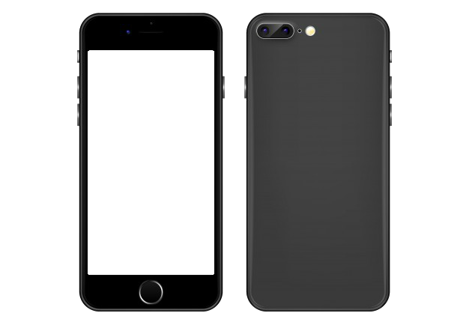

Project Goal
Safe Driving Application
YOUR DESTINATION IS REWARD FOR SAFE DRIVING
Safe driving app by using both front and rear cameras in smartphone
Front camera
Drowsiness detection with machine learning in mobile
Rear camera
Changeable lane detection with image processing algorithm

Slide 7
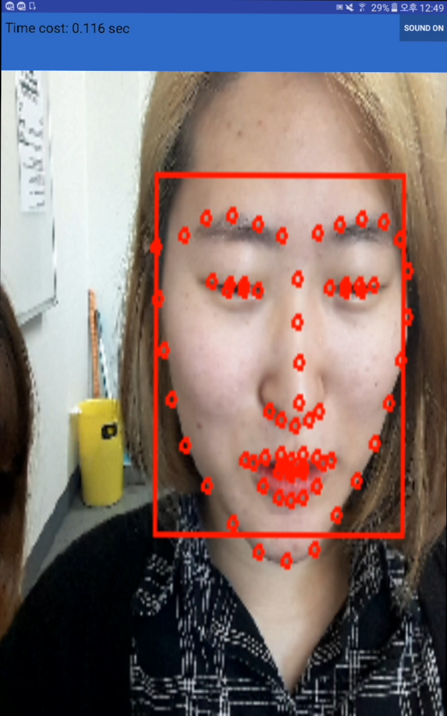
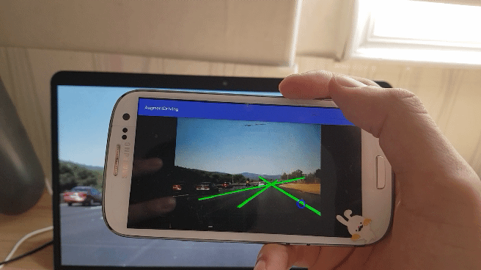
DEMO
Safe Driving Application
YOUR DESTINATION IS REWARD FOR SAFE DRIVING
Lane Detection
Drowsiness Detection

Slide 8
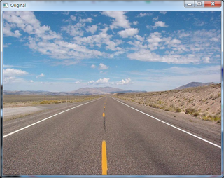
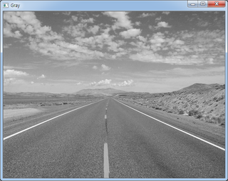
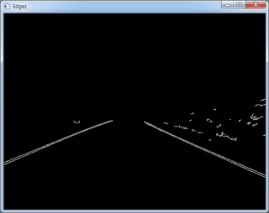
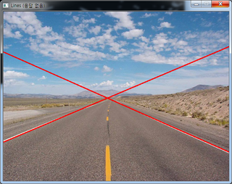
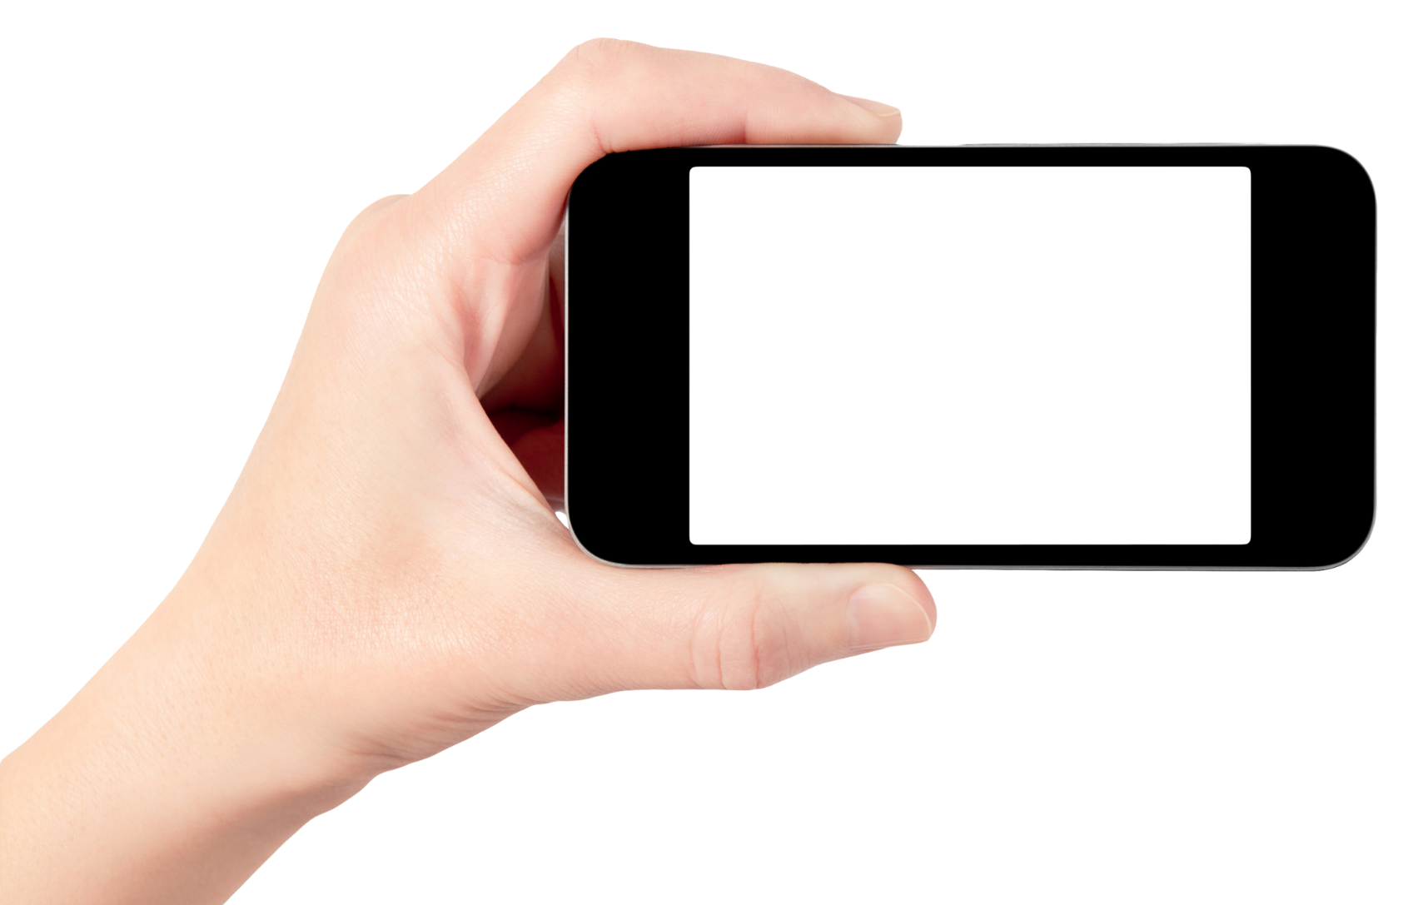

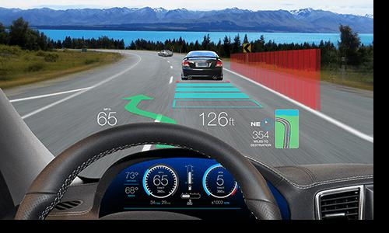


Feature 1: Lane detection
Safe Driving Application
YOUR DESTINATION IS REWARD FOR SAFE DRIVING
Lane Detection
Realtime recognition of changeable lane
Notification of changeable lane using AR Object
JNI

Slide 9
Feature 1: Lane detection
Safe Driving Application
YOUR DESTINATION IS REWARD FOR SAFE DRIVING
Lane Detection
Lane detection algorithm is used (Hough Transform Algorithm)
OpenCV for C++ and JNI are used for better performance of image processing (via using native codes instead of interpreting codes)
JNI

Slide 10
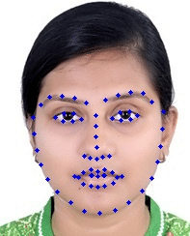
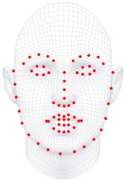
Feature 2: Drowsiness detection
Safe Driving Application
YOUR DESTINATION IS REWARD FOR SAFE DRIVING
“Dlib Toolkit”
Machine learning algorithm toolkit for c++
Contains 68 face landmarks extraction function
Ex) left eyes are from 36 to 41.
Ex) right eyes are from 42 to 47
Reference: Real-time eye blink detection using facial landmarks(2016)

Slide 11
Feature 2: Drowsiness detection
Safe Driving Application
YOUR DESTINATION IS REWARD FOR SAFE DRIVING
If the average eye aspect ratio of left and right eye less than 0.2, the status is sleeping.
d(p2, p6) + d(p3, p5)
2 * d(p1, p4)
Eye aspect ratio =

Slide 12
Acheivement
Safe Driving Application
YOUR DESTINATION IS REWARD FOR SAFE DRIVING
JNI

Slide 13
Improvements (if possible)
Safe Driving Application
YOUR DESTINATION IS REWARD FOR SAFE DRIVING
Combine two functions into one application
Improve application’s user interface
3. Apply more accurate detection algorithm

Slide 14
Marketing Plan
Notes:
안녕하세요, 증강도로주행을 주제로 발표를 맡은 이유호입니다.

Slide 15
STP -Segmentation
Safe Driving Application
YOUR DESTINATION IS REWARD FOR SAFE DRIVING
Demographic variables
Age -Ages which has many people who drive
Gender -Gender which has many people who drive
Job -A job to drive for a long time or a lot.

Slide 16
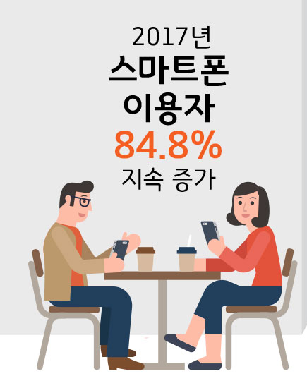
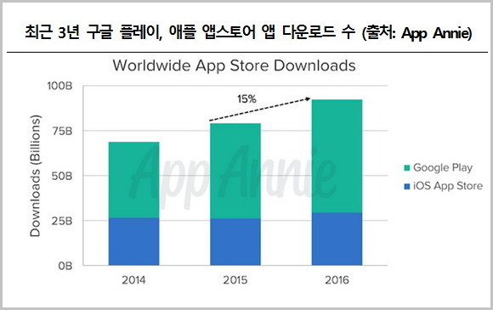
STP -Segmentation
Safe Driving Application
YOUR DESTINATION IS REWARD FOR SAFE DRIVING
Psychoanalytic variables
Most drivers has smartphone and use applications

Slide 17
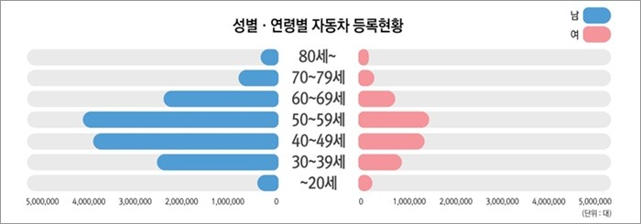
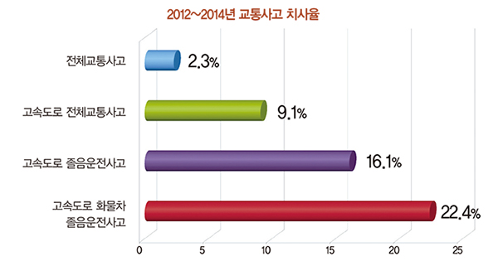
STP -Targeting
Safe Driving Application
YOUR DESTINATION IS REWARD FOR SAFE DRIVING
Age -Ages which has many people who drive
People in age 40 – 50
Gender -Gender which has many people who drive
Men drive a lot than women
Job -A job to drive for a long time or a lot.
Transit drivers, Agent drivers, …

Slide 18

STP -Positioning
Safe Driving Application
YOUR DESTINATION IS REWARD FOR SAFE DRIVING
KOKIO
Lane Identification Pro
Drowsiness detection
Lane detection
Ours
Anti Drowsiness Alarm
Simple UI
Notes:
차선 인식
졸음경고

Slide 19
SWOT -Strengths
Safe Driving Application
YOUR DESTINATION IS REWARD FOR SAFE DRIVING
Smartphone Application
Since every driver has own smartphone, we don’t have to wait other too early to adopt solution.
Light-weight machine learning application
‘Dlib’ library provides machine learning implementation with low-battery latency.
Both front camera and rear camera are used.

Slide 20
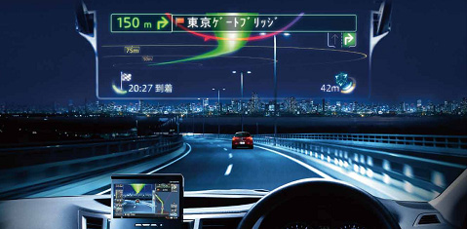
SWOT -Weaknesses
Safe Driving Application
YOUR DESTINATION IS REWARD FOR SAFE DRIVING
Smartphone must be located at specific position.
No service for iOS users, it is based on Android.
Lane detection by smartphone isn’t able to recognize lanes for 100% accuracy
weather condition, light condition etc.
Weak UI

Slide 21
SWOT -Opportunities
Safe Driving Application
YOUR DESTINATION IS REWARD FOR SAFE DRIVING
Drowsy driving has been spotlighted in safe driving system.
Auto driving system is a keyword in next generation technology.
Feature such as lane detection in this application shows opportunity for automatic driving.
It can be alternatives for too early adopted technology.
ex) HUD display etc.

Slide 22
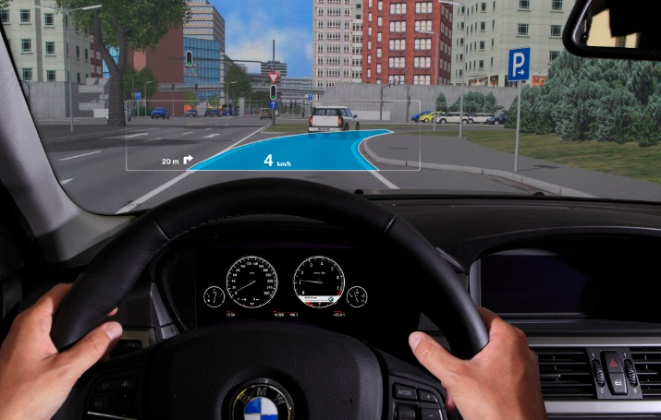
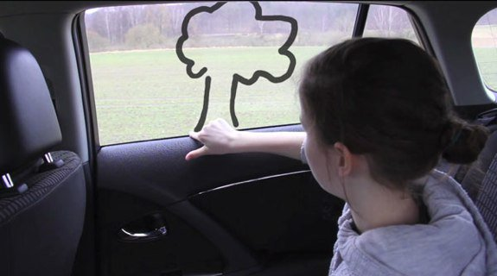
SWOT -Threats
Safe Driving Application
YOUR DESTINATION IS REWARD FOR SAFE DRIVING
Smartphone application is used no longer during driving.
Ex) HUD display etc.

Slide 23
Reference
Safe Driving Application
YOUR DESTINATION IS REWARD FOR SAFE DRIVING
Real-time eye blink detection using facial landmarks(2016)
App Annie
http://f1nger.com/portfolio/%EC%8A%A4%EB%A7%88%ED%8A%B8%ED%8F%B0-%EB%B3%B4%EC%9C%A0-%EB%B0%8F-%EC%9D%B4%EC%9A%A9%ED%98%84%ED%99%A9-%EC%9D%B8%ED%8F%AC%EA%B7%B8%EB%9E%98%ED%94%BD/
http://slownews.kr/67025
http://www.carvi.co.kr/

